Slide 1
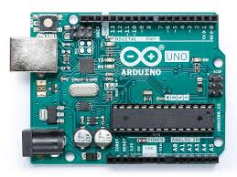

Computer
Slave 1 (1)
Train
Controls the location of the train
Interfaces with the ultrasonic sensor
Slave 2 (2)
Dispenser
Controls the stepper motors of the dispenser
Processing
GUI (sliders/buttons)
Communicates with Arduino using Firmata
I2C Communication
USB
Slave 3 (3)
Gripper
Stepper motors
Servos
Limit switches
Slave 4 (4)
Mixer/Former
Controls the motors of the mixer and former
Master ()
Running Firmata for easy communication with Computer using USB

